Slide 1



BYU Management Society Africa Business Plan Competition 2026
MWANA MBOKA LOGISTICS SARLU
Yoane Kabambire_Founder & CEO
Lubumbashi, Haut-Katanga, DRC
“Empowering farmers today to feed Africa tomorrow”
Notes:
Company logo of you can fit it in

Slide 2
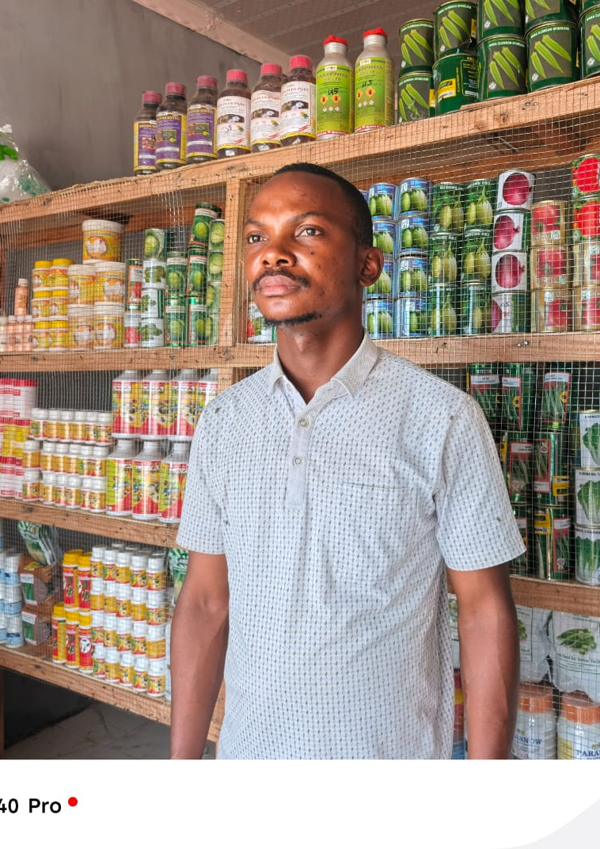
Executive Summary
Founded in 2022, MWANA MBOKA LOGISTICS SARLU is an agricultural logistics and distribution company based in Lubumbashi DRCongo. We provide certified seeds, fertilizers, and poultry inputs through four strategically located depots, serving an average of 48 active customers per month.
With a 13-person team (depot managers, field agents, logistics partners) and average of 20,96% gross margin, we ensure fast, traceable, and affordable delivery powered by whatsapp ordering and Excel/Cloud tracking.
Our goal is to become the most reliable and accessible agricultural distributor in Haut-Katanga, promoting local employment and sustainable farming logistics

Slide 3
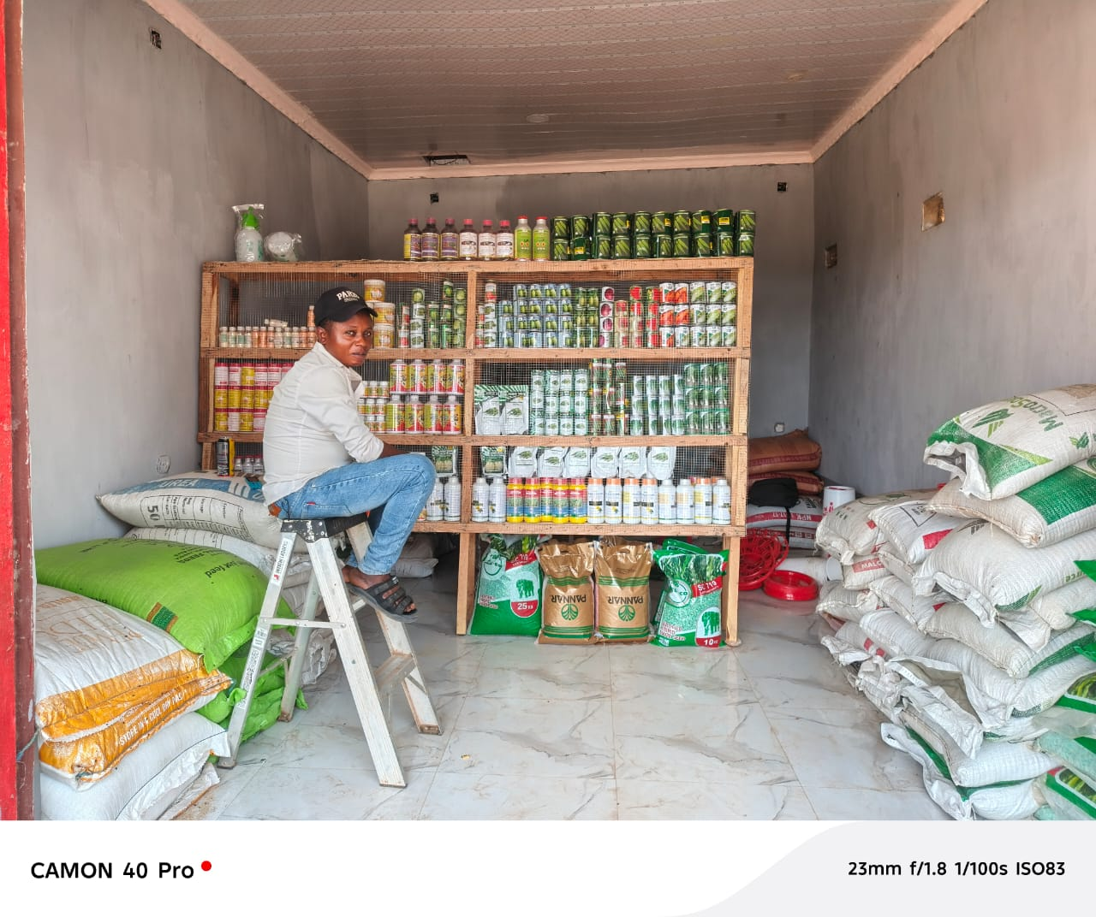
Problem/Customer Pain Point
Local context: Farmers in Haut-Katanga spend up to 30% more due to unreliable inpunt supply
70% of smallholder farmers lack access to certified seeds and fertilizers
Delivery delays increase costs and reduce yields
Unstable prices due to limited supply chains
Few reliable distributors serve ruram areas
Impact: Lower productivity, income loss, dependence on imported inpunts
Sources:
FAO Reports (2023), DRC Ministry of Agriculture, J-PAL evaluation inpunt acess (2022).

Slide 4
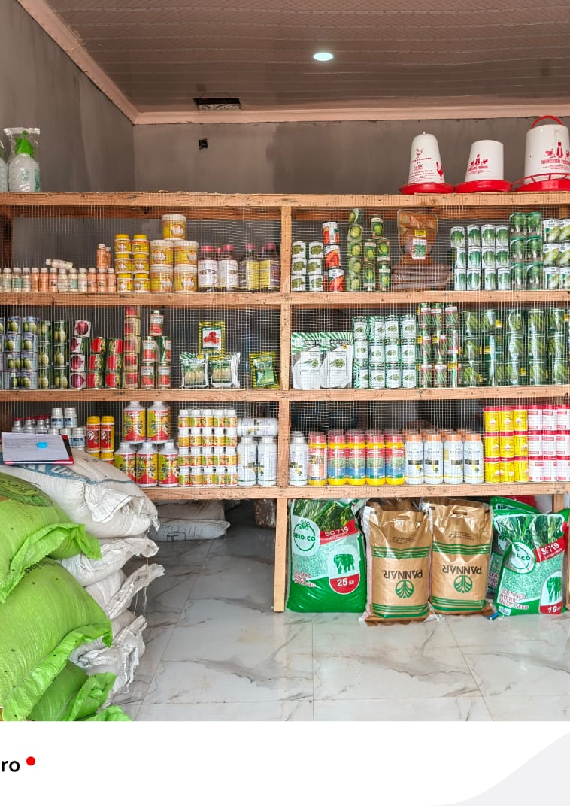
Business Venture, Product or Services
Our solution:
MWANA MBOKA Builds a decentralized depot network connecting rural farmers to verified suppliers through digital and local channels
How it works:
Orders placed via whatsapp or local agents
Depots process and dispatch through a shared logistics network
Delivery within 24-48 hours , digitally tracked
Value proposition:
Certified, reliable inpunts
Shorter delivery times
Competitive prices
Personal farmer support via field agents

Slide 5
Cost Structure
Category | Share | Description
Procurement | 50-55% | Certified seeds, Fertilizers, poultry inpunts
Depot Operations | 25% | Rent, Utilities, Staffing
Transport & Delivery | 10-15% | Inter-depot and Rural deliveries
Marketing | 3% | Flyers, Campaigns, Whatsapp
Administration | 2% | Accounting, Communication
Revenue Sources: Direct depot sales, bulk to coopératives, commissions from rural retailers. Gross Margin : 20-23%

Slide 6
Market Size and Growth
ELEMENT | KEY INSIGHTS
Target Market | Small/Medium farmers, coopératives, poultry producers in Lubumbashi, Kipushi ,Fungurume & Kasumbalesa
Market size (Local) | About $10 million/year, growing 7,5% annualy(FAO 2024)
Customers needs | Reliable supply, stable prices, expert advice, quick delivery
Competitors | Small informal distributors, weak logistics, poor stock consistency
Market trends | Modern inpunt adoption, poultry boom, mobile ordering
Expansion potential | New depot in Kasumbalesa and Fungurume (2026)
Risk Mitigation | Multiple suppliers, Whatsapp tracking, regular audits
Goal: grow local Market share from 0,44% (2024) to 1,5% (2026)

Slide 7
Marketing and Sales Strategy
Element | Description
Customer Acquisition | 6 Trained field agents manage rural outreach, collect orders, and coordinate deliveries
Pricing strategy | Competitive, transparent, with volume discounts for loyal and cooperative clients
Promotion strategy | Social media (Facebook, Tik-Tok, Instagram),Flyers, posters, and whatsapp campaigns
Distributions channels | Four depots linked by rural delivery routes and logistics partners
Marketing budget | USD 250, 50 Social media, 100 Flyers/Posters, 50 Whatsapp outreach
Expected impact: +46% client base growth in 2026

Slide 8
Financials
Historical Financial Overview (2022-2024)
Year | Revenue | Expenses | Profit | Profit Margin
2022 | $ 123 043 | $ 100 907 | $ 22 136 | 17,99%
2023 | 144 515 | 112 482 | 32 033 | 22,17%
2024 | 129 858 | 99 795 | 30 063 | 23,15%
Average growth: +6,7% annual revenue, +16% profit

Slide 9
Monthly breakdown 2022
Month | Revenue | Expenses | Profit | Profit Margin
January | $ 10 212 | $ 8 097 | $ 2 115 | 20,71%
February | 9996 | 8036 | 1960 | 19,61%
March | 9880 | 7847 | 2033 | 20,58%
April | 9970 | 8855 | 1115 | 11,18%
May | 10541 | 8188 | 2353 | 22,32%
June | 10049 | 8897 | 1152 | 11,46%
July | 9997 | 8906 | 1091 | 10,91%
August | 10417 | 8860 | 1557 | 14,95%
September | 10893 | 7741 | 3152 | 28,94%
October | 10613 | 8830 | 1783 | 16,80%
November | 9892 | 8561 | 1331 | 13,46%
December | 10583 | 8089 | 2494 | 23,57%
Total | $ 123 043 | $ 100 907 | $ 22 136
Average | $ 10 254 | $ 8 409 | $ 1 845 | 17,87%

Slide 10
Monthly breakdown 2023
Month | Revenue | Expenses | Profit | Profit Margin
January | 12 647 | 9 720 | 2 927 | 23%
February | 13 123 | 9 269 | 3 854 | 29%
March | 10 921 | 9 609 | 1 312 | 12%
April | 11 487 | 9 706 | 1 781 | 16%
May | 11 893 | 9 801 | 2 092 | 18%
June | 11 464 | 9 483 | 1 981 | 17%
July | 13 150 | 9 025 | 4 125 | 31%
August | 12 040 | 9 178 | 2 862 | 24%
September | 12 193 | 9 050 | 3 143 | 26%
October | 12 029 | 9 073 | 2 956 | 25%
November | 11 127 | 9 187 | 1 940 | 17%
December | 12 441 | 9 381 | 3 060 | 25%
Total | 144 515 | 112 482 | 32 033
Average | 12 043 | 9 374 | 2 669 | 21,87%

Slide 11
Monthly breakdown 2024
Month | Revenue | Expenses | Profit | Profit Margin
January | 10 796 | 8 214 | 2 582 | 24%
February | 10 701 | 7 876 | 2 825 | 26%
March | 10 657 | 8 284 | 2 373 | 22%
April | 10 742 | 8 624 | 2 118 | 20%
May | 10 696 | 7 869 | 2 827 | 26%
June | 10 822 | 8 467 | 2 355 | 22%
July | 11 087 | 8 084 | 3 003 | 27%
August | 10 739 | 8 647 | 2 092 | 19%
September | 10 922 | 8 398 | 2 524 | 23%
October | 10 779 | 8 368 | 2 411 | 22%
November | 11 062 | 8 505 | 2 557 | 23%
December | 10 855 | 8 459 | 2 396 | 22%
Total | 129 858 | 99 795 | 30 063
Average | 10 822 | 8 316 | 2 505 | 23,14%

Slide 12
2025-2026 Forcasts
Forcast assumes new depot in kasumbalesa or Fungurume and extended poultry supply chain
Year | Scenario | Revenue | Expenses | Profit | Profit Margin
2025 (Expected) | Stable growth | $ 138 000 | $ 106 000 | $ 32 000 | 23,2%
2026 (Target) | Expansion Phase | $ 155 000 | $ 122 000 | $ 33 000 | 21,3%
Assumptions:
7% annual market growth
46% Client base increase
Moderate cost inflation offset by economies of scale

Slide 13
Risk Factors and Mitigation
Risk Factor | Potential Impact | Mitigation Strategy
Supplier price fluctuations | Reduced profit margin | Secure contracts, diversify sourcing
Seasonal cash flow variation | Stock or delivery delays | Maintain safety stock and flexible pricing
Fuel/Transport costs | Increased expenses | Optimize delivery routes, shared transport
Market competition | Pressure on sales | Strengthen customer relations, fast delivery

Slide 14
Management Team
NAME | ROLE | EXPERIENCE | STRENGTH
Yoane Kabambire | Founder & CEO | 5+ years in logistics, sales and customers relationship, and agribusiness leadership | Leadership & Innovation
4 Depot Managers | Operations & and client satisfaction. | Retails management backgrounds | Reliability & Efficiency
6 Sales Agents | Client acquisition & delivery | Agricultural promotion | Proactive, client focused
3 Logistics partners | Supply chain & Transport | Experience suppliers | Timely, flexible routes
Training plan (2025-2026): With INPP & FAO on digital sales and inventory
Philosophy: « We grow by empowering our people »

Slide 15
Use of Prize Money
Use | Amount (USD) | Objective & Impact on Growth | Quarter of Implementation
Stock increase | 3,000 | Expand inventory to meet growing farmer and cooperative demand,ensuring regular availability, reducing stock-outs , and increasing sales by +30% | Q1-Early 2026
Marketing & Communication | 450 | Develop a professional website (250 USD) to strengthen visibility and facilitate online orders. Invest the remaining 200 USD in social media compaigns (Facebook, Tik-Tok, Instagram) and local Flyers/Posters to enhance awareness and customer acquisition | Q2-Mid 2026
Rent Guarantee | 550 | Secure a central depot for 12 months, improving accesibility,reduicing logistics costs, and boosting trust with clients and suppliers | Q3-Mid 2026
Capital & Internal rotation | 10,750 | Support daily operations (transportation, working capital, staff incentives) and reinvest in fast moving items to sustain business growth | Continuous -2026
Why we believe in this Business
Our model has proven demand and operational efficiency in the Haut-Katanga region. With a growing network of agents and depots, the prize money will accelerate our digital presence, distribution capacity, and supply reliability. This initiative directly contributes to local employment, rural income stability, and food supply efficiency, making it both financially sustainable and socially impactful.

Slide 16
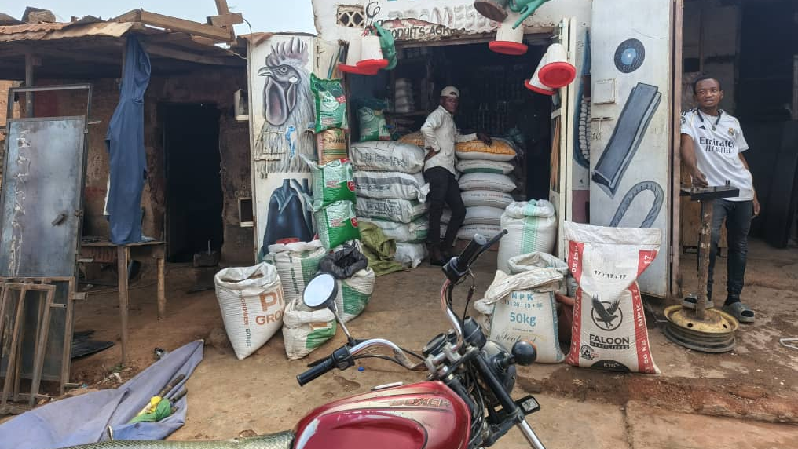

Slide 17
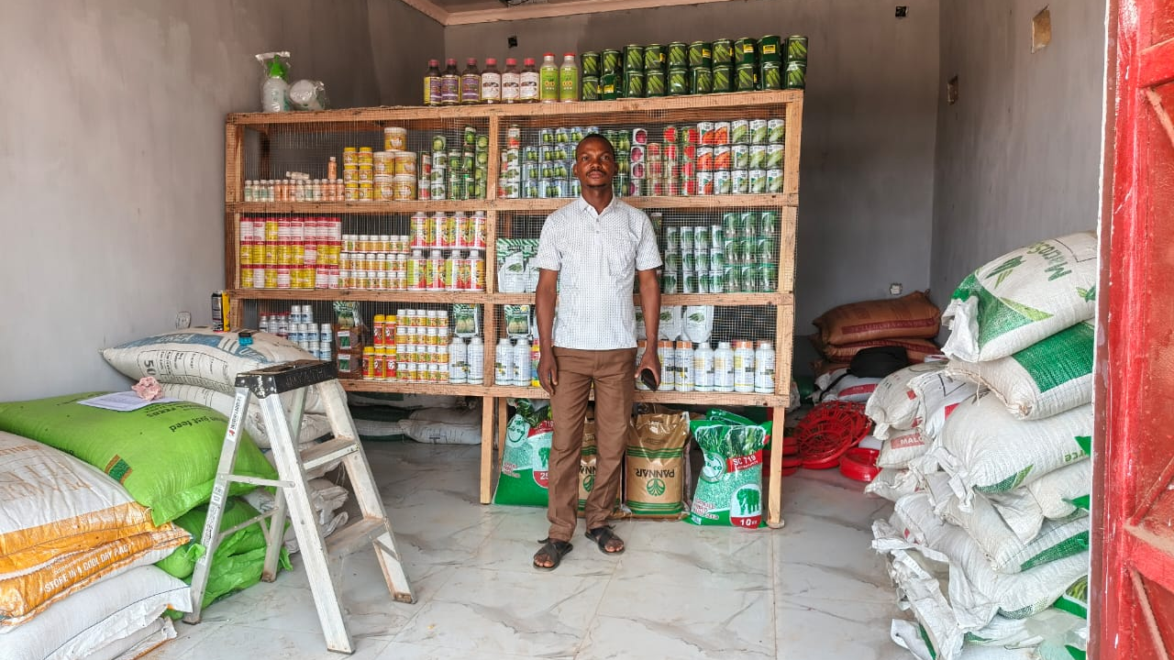

Slide 18
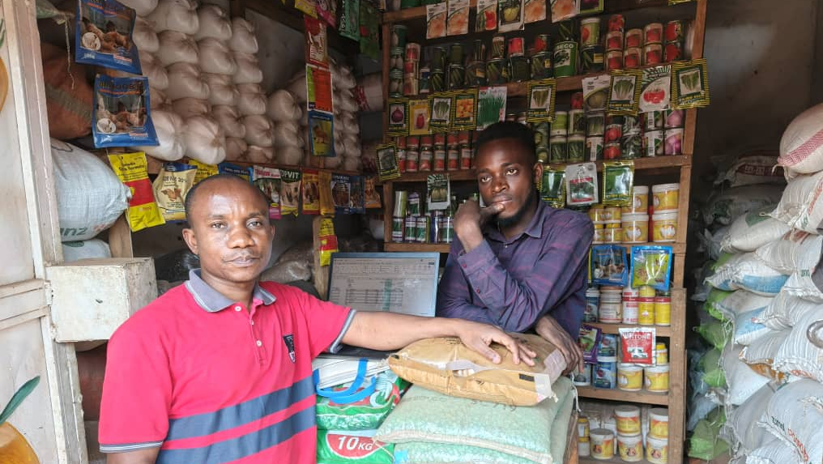

Slide 20
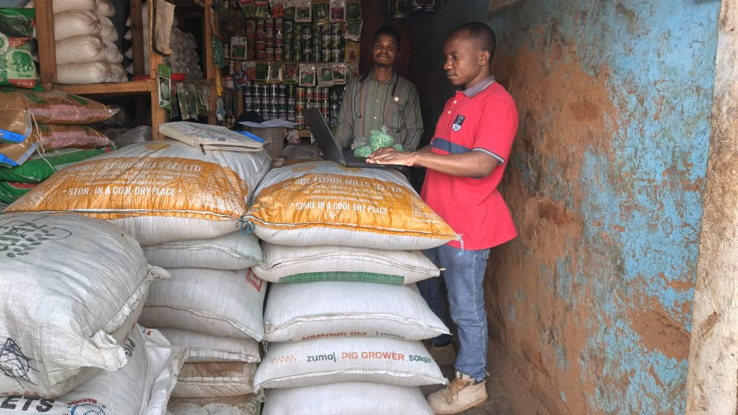

Slide 21
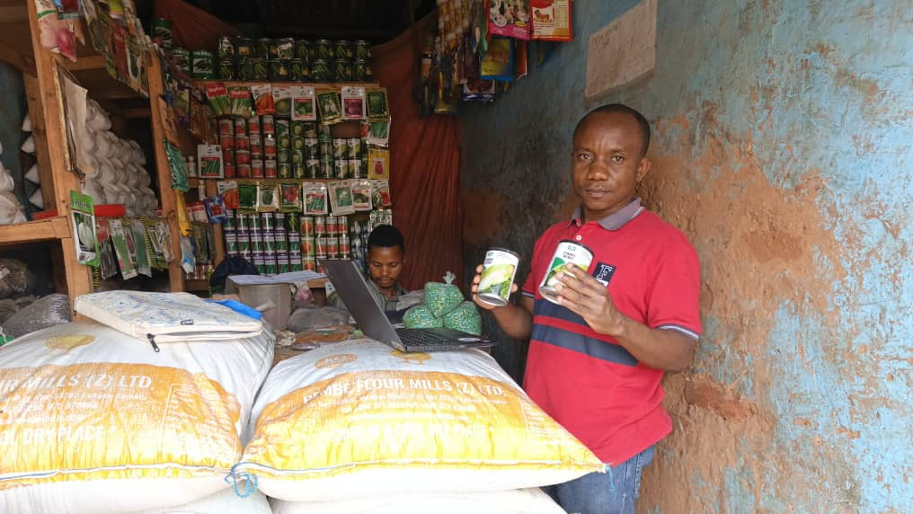

Slide 22
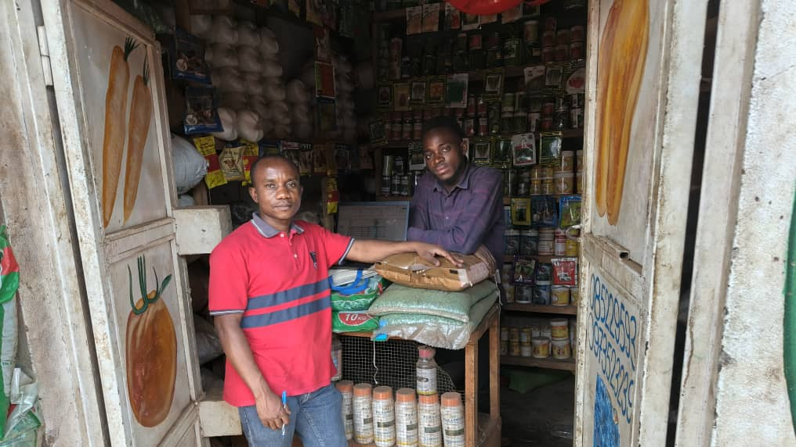

Slide 23
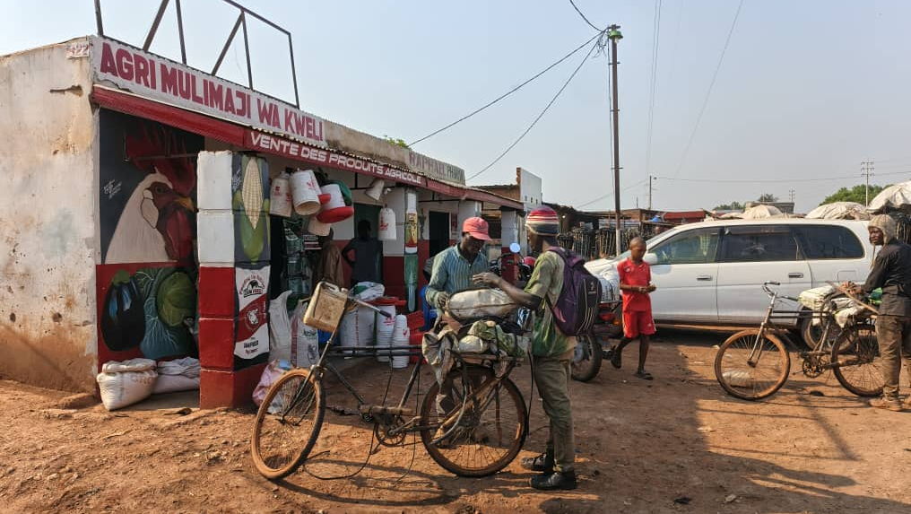

Slide 24
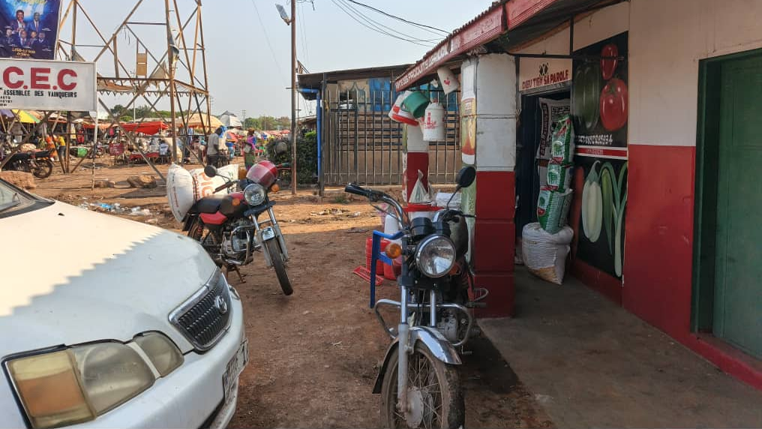

Slide 25
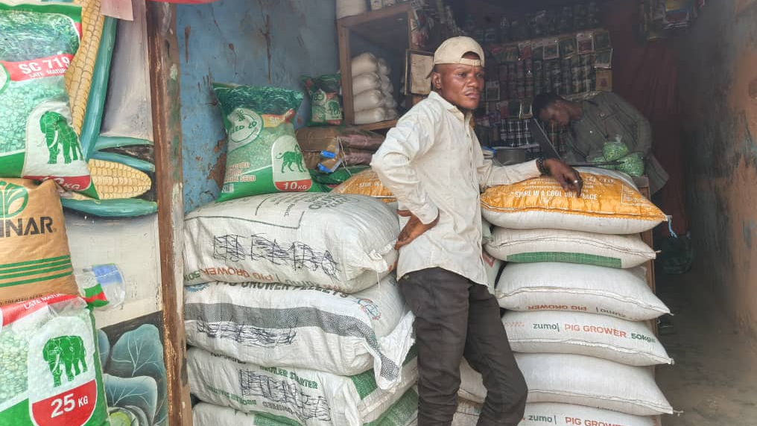

Slide 26
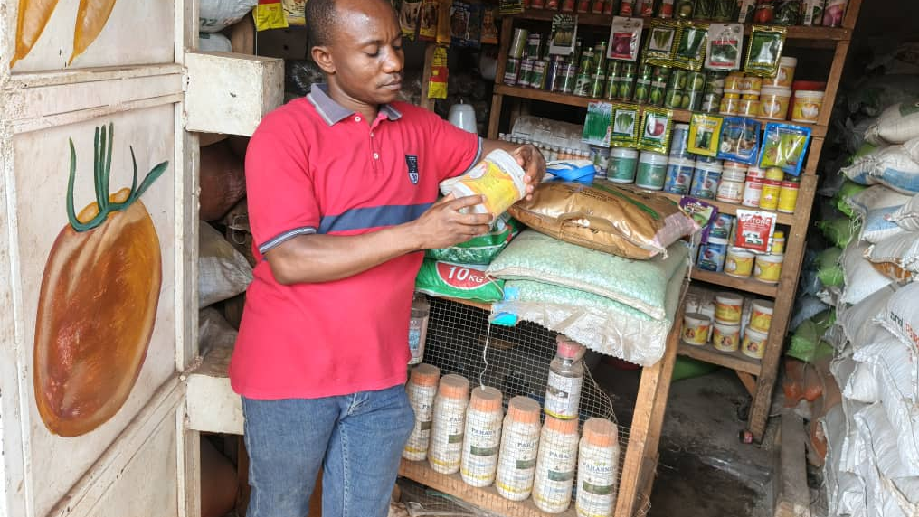

Slide 27
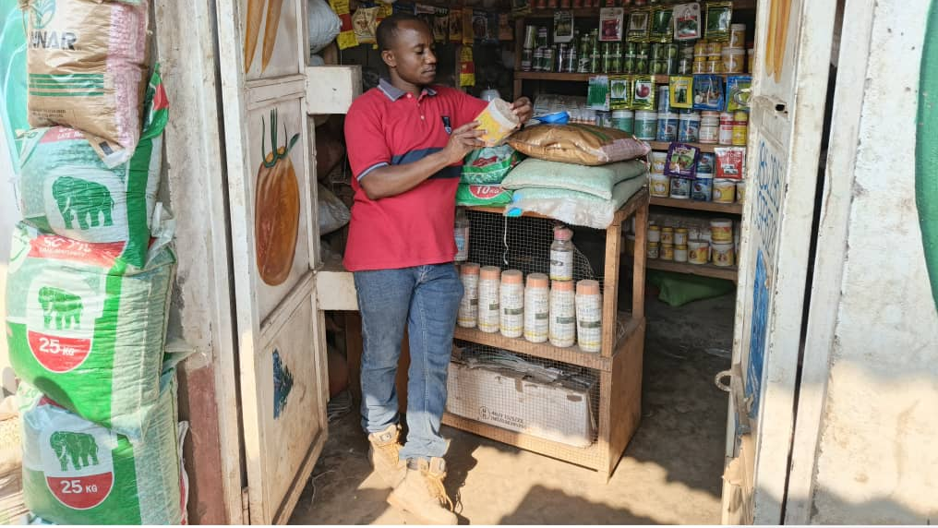

Slide 28
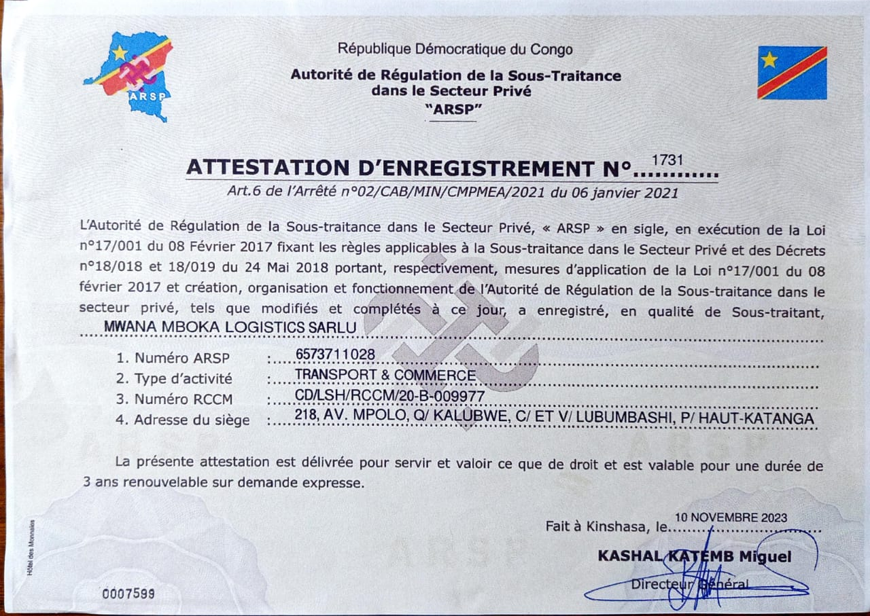
Business Registration/Licenses

Slide 29
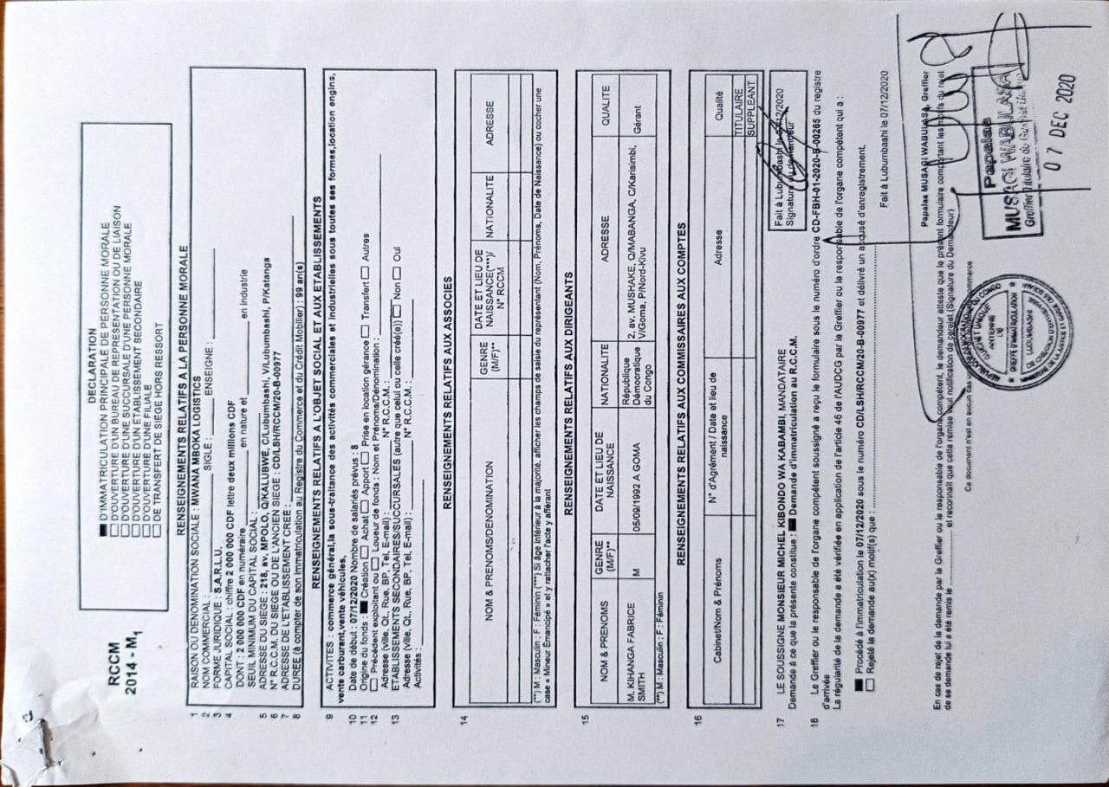

Slide 30
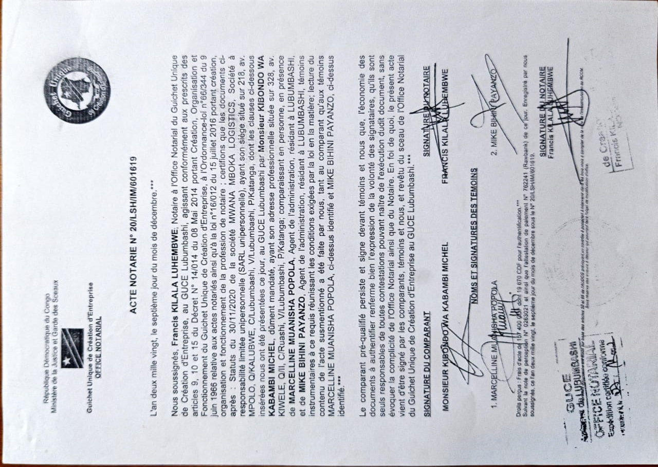

Slide 31
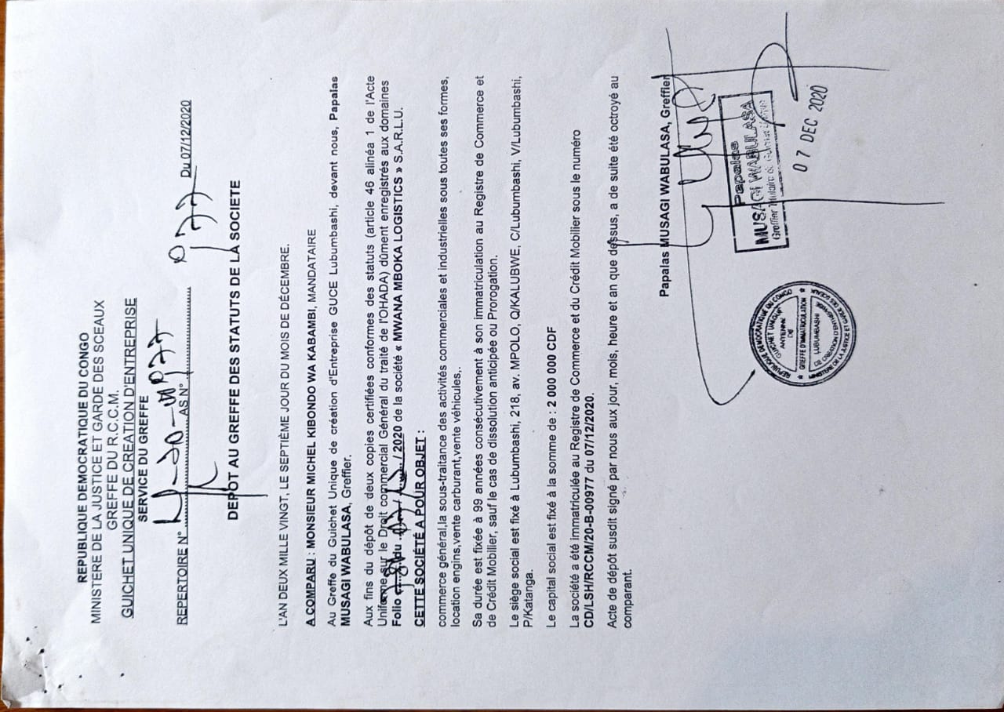

Slide 32
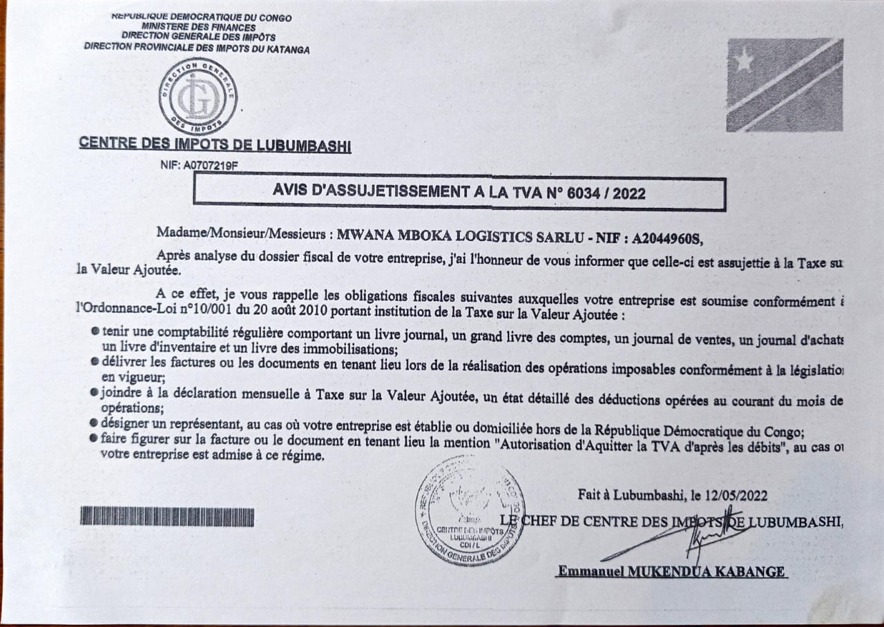

Slide 33
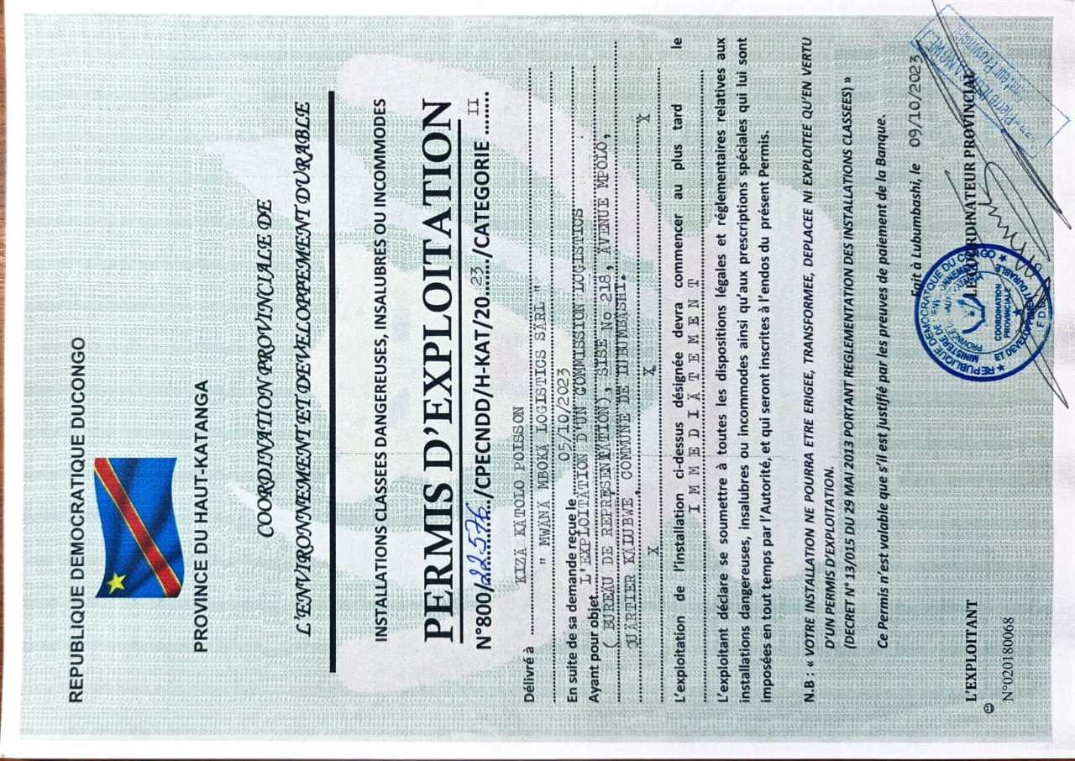

Slide 34
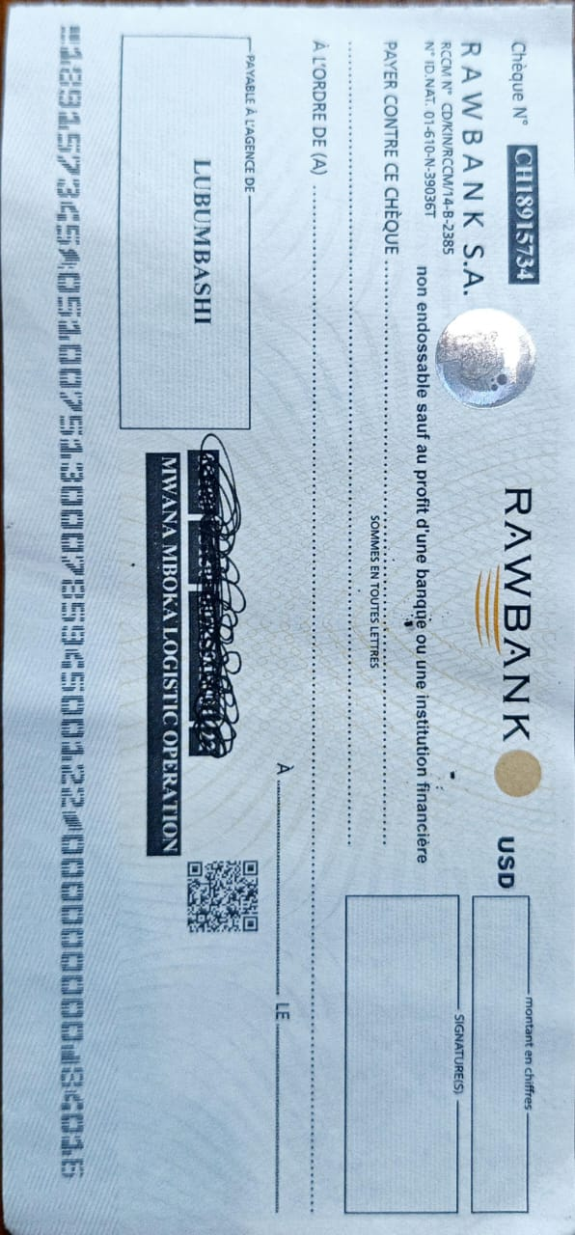

Slide 35
Conclusion
MWANA MBOKA LOGISTICS SARLU bridges rural supply gaps through an efficient, digital, and community-based distribution model
“-This is not just a business; it’s a bridge between farmers and their future-”
With BYU support , we will scale operations, expand our depot network, and strengthen rural supply chains driving both profit and social impact
“Empowering farmers today to feed Africa tomorrow”

